Slide 1
OPTICAL DEVICE FOR MEASURING THE PARAMETERS OF A SNOWSTORM
Filatov Dmitry, postgraduate
IMCES SB RAS
Notes:
Good morning / afternoon / evening respected colleagues and chairpersons.

Slide 2
Сontents
Snowstorms and their impact
Snowstorm meters
FlowCapt FC4
Snow particles counter (SPC)
Precipitation meter OPTIOS
OPTIOS measurement results
Design features of the new snowstorm meter
Notes:
In the course of this talk, I will elucidate the nature and significance of snowstorm meters (№1); furthermore I will show (№2 - №4) examples of existing snowstorm meters that are currently in use, let you take a look at the principle of their work; then we will learn what OPTIOS is, being one of these wonderful machines (№5) and we will discuss in detail a design of our own that is being developed at IMCES SB RAS, a snowstorm meter based on OPTIOS (№6); at the very end (№7) we will summarize and draw several conclusions, after which you can ask your questions, should you have any.

Slide 3
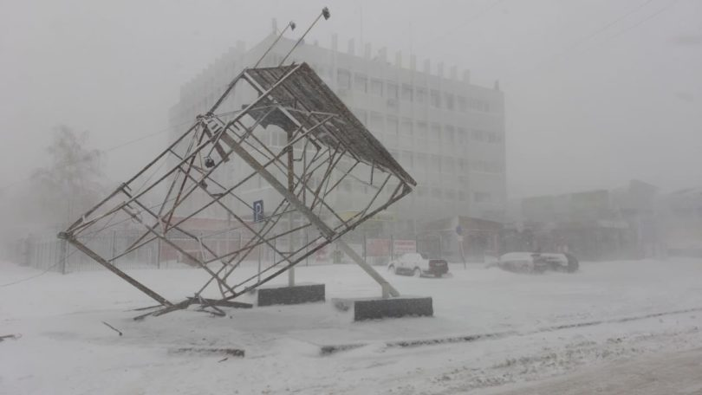
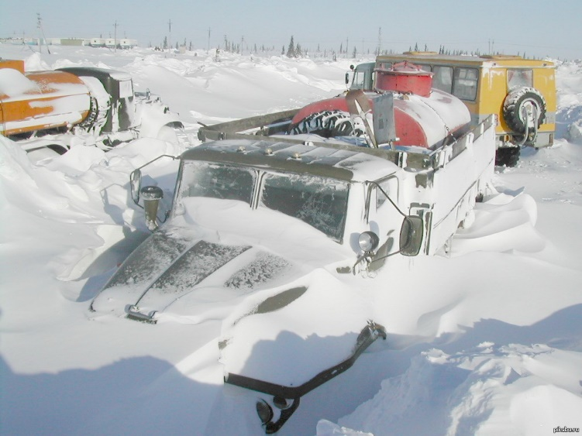
Snowstorms and their impact
The aftermath of the snowstorms
Notes:
In countries with cold winters, and severe winter conditions, like the Russian Federation, snowstorms have a huge economic impact and pose serious security risks structure- and infrastructurewise. Snowstorms form snowdrifts, hindering the operation of air, road and rail transport, change the distribution of snow masses in the fields, affecting the distribution of moisture in the soil and, as a result, the crop yields. Snowstorms create an increased avalanche hazard in areas with difficult terrain. Information on local snow transfer is used both in the design of roads and by public utilities
There is a number of automatic meters that can determine some parameters of horizontal snow transfer, but these are not widely used. They include:
• FlowCapt FC4
• SPC

Slide 4
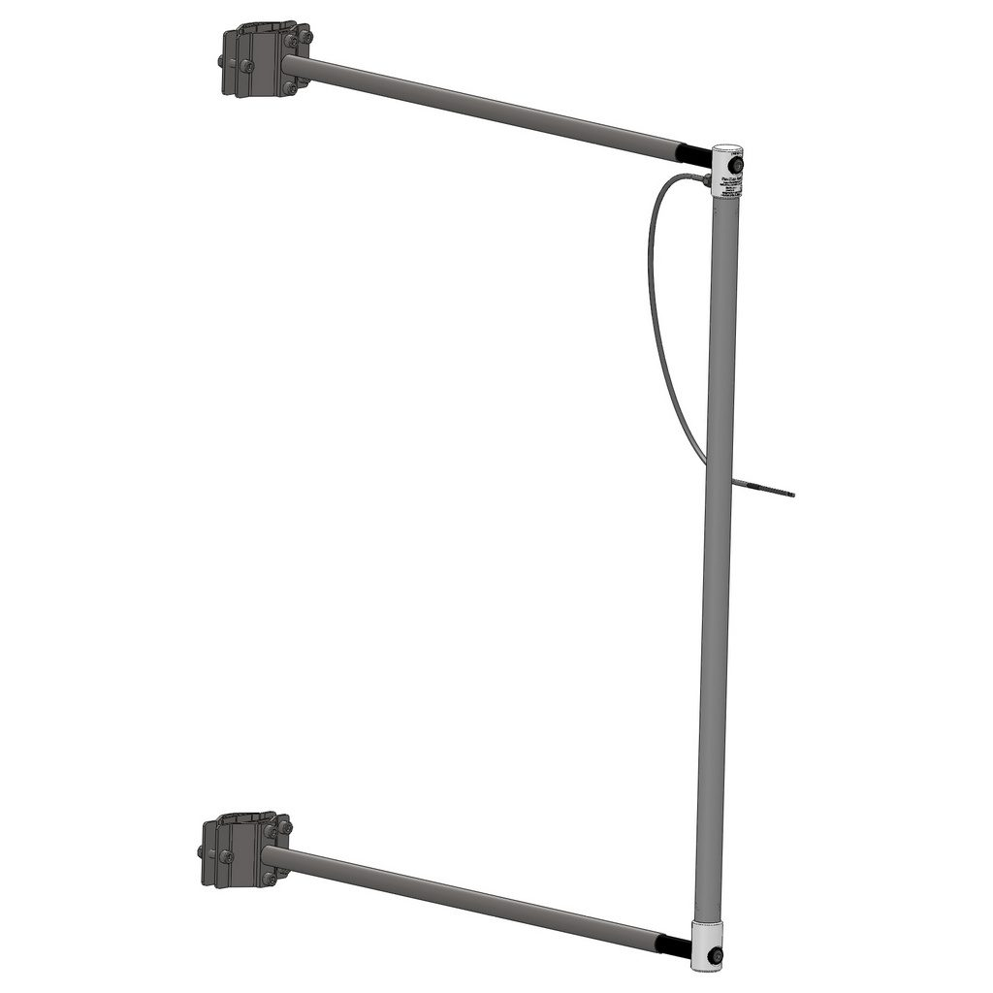
FlowCapt FC4
PRINCIPLE OF OPERATION:
Internal acoustic pressure.
ADVANTAGES:
Auto mode;
Non-volatile power;
Protective covering;
Lack of moving parts;
No maintenance needed.
DISADVANTAGES:
Small number of measured parameters of snowstorms.
FlowCapt FC4
Notes:
The FlowCapt FC4 ultrasonic sensor, which works on the principle of recording changes in the internal acoustic pressure generated due to friction of snow particles on the sensitive surface of the sensor. The advantages of this device include automatic operation, non-volatile power supply, protective coating, the absence of moving parts and the lack of need for maintenance. A significant drawback is the small number of measured parameters of snowstorms (the intensity of the flow of snow particles).

Slide 5
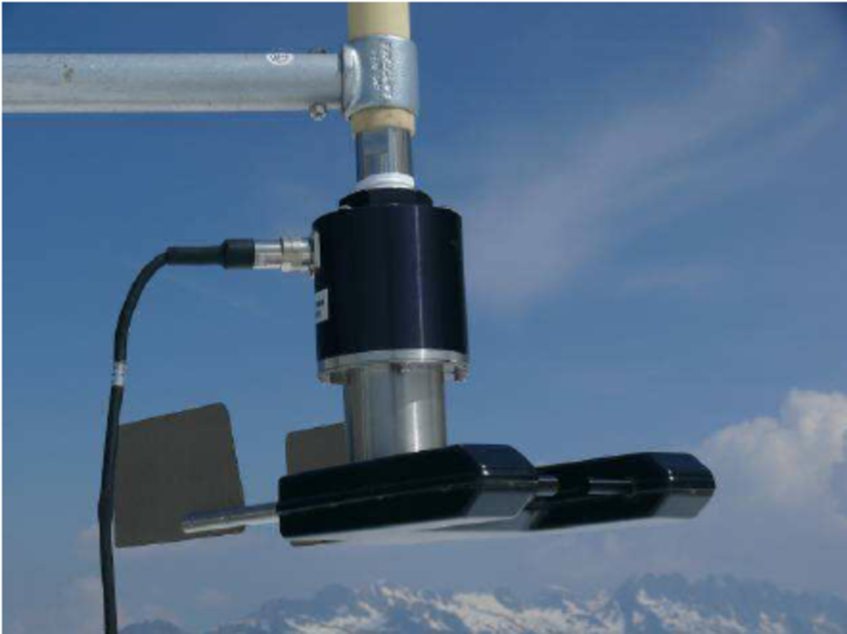
Snow particles counter (SPC)
PRINCIPLE OF OPERATION:
Absorption of particles of emitted light.
ADVANTAGES:
Auto mode;
High sensitivity.
DISADVANTAGES:
Small number of measured parameters of snowstorms.
SPC
Notes:
Another device is the snow particle counter (SPC), which is a classic photoelectric fork sensor capable of counting the number of particles and measuring the diameter of particles as they pass through the measuring volume. Its advantages are high sensitivity and the ability to work in automatic mode, and the main disadvantage is the limited number of measured parameters.

Slide 6
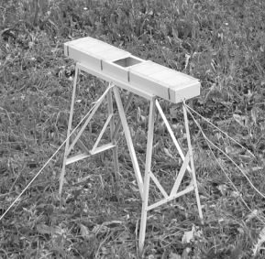
Precipitation meter OPTIOS
PRINCIPLE OF OPERATION :
Shadow images.
ADVANTAGES:
Auto mode;
Lack of moving parts;
No maintenance needed;
The presence of a thermal control system.
LIMITATIONS:
The presence of only a horizontal plane of measurement;
Low scan rate for snowstorm particles.
OPTIOS
Notes:
Optical precipitation meter called OPTIOS created in the laboratory) of ecological instrumentation. It makes and analyzes the images of shadows cast by atmospheric precipitation particles. Based on the measurement of particle sizes and their quantity, the current depth and amount of precipitation are determined. The device operates in automatic mode, has low power consumption; it accounts for wind and high wind resistance bias as well as measurement errors arising from wetting and evaporation. OPTIOS provides the opportunity to determine the integral and microstructural characteristics of precipitation. So, what is wrong with OPTIOS, you might ask, well, it’s designed to measure particles transferred vertically only.

Slide 7
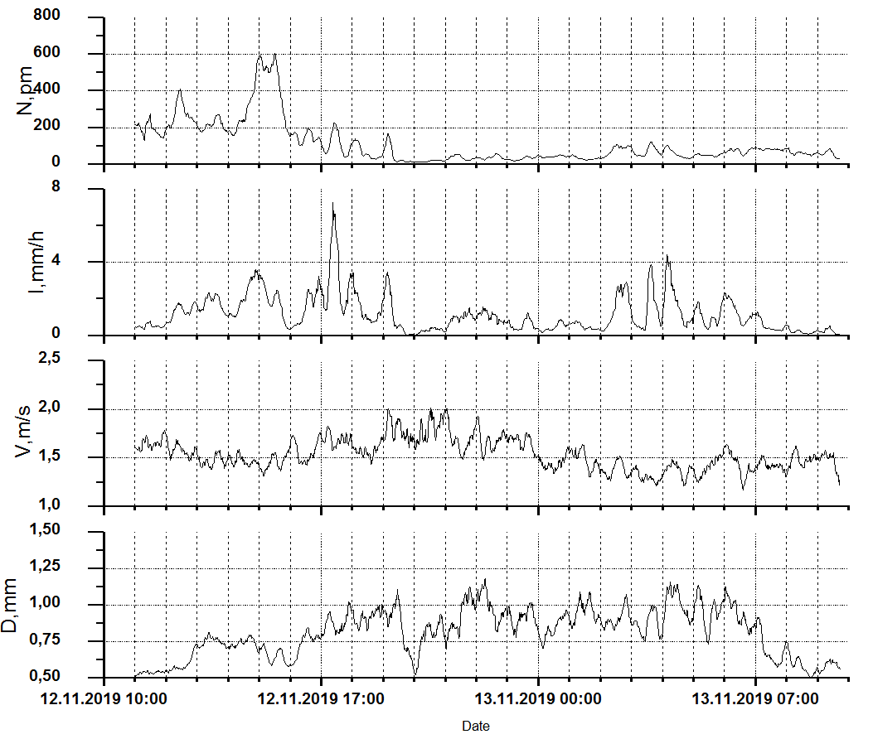
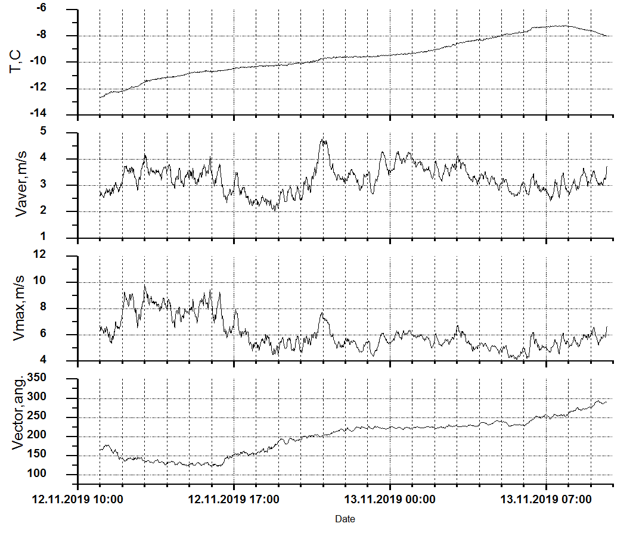
OPTIOS measurement results
Measurement results
Notes:
Over the period under consideration, the speed of snowfall particles v averaged around 1.5 meters per seconds, with big particles travelling as fast as 3 meters per seconds. At the same time, the average horizontal wind speed V was 3-5 m / s, with gusts (Vmax) up to 10 meters per seconds. OPTIOS cannot measure the parameters of snowfall accompanied by strong winds correctly due to the lack of a vertical measuring plane.

Slide 8
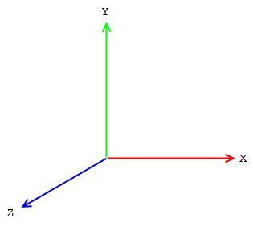
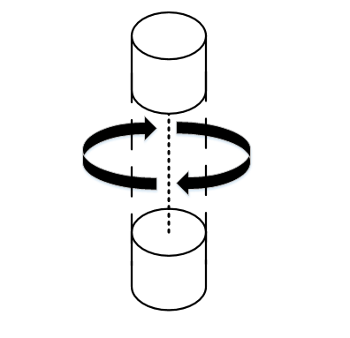
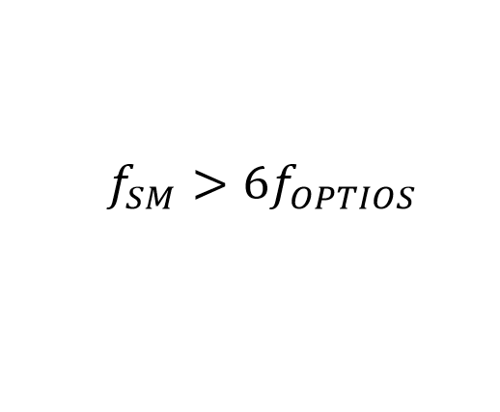
Design features of the new snowstorm meter
Three measurement planes
Rotating parts
Scan rate
Notes:
From the graph we can see that wind direction D changes diametrically in less than a day. This means that a vertically positioned measuring platform should be able to automatically change orientation in the horizontal plane to align with the direction of the wind. Thus the design of the positioning system must inevitably contain moving elements, which in severe operating conditions is extremely undesirable. A possible technical solution in this case could be the development of a device equipped with a two-dimensional measuring region created by two perpendicular vertical measuring channels.
An additional condition for the design of the new snowstorm meter is the speed of registration of particles. The speed of a snowstorm particle is twice to three times the average speed than the speed of a raindrop. The particle size of the snowstorm in this case is twice to three smaller than raindrops. Therefore, the optoelectronic components of the device under development should provide a scanning frequency of shadow images of snow particles not less than six times higher than the frequency calculated for the OPTIOS optical rain meter.

Slide 9
Thank you for your attention!
Notes:
So, I hope I was able to introduce you to the snowstorm meters and demonstrate the design of the new snowstorm meter being developed at IMCES SB RAS. You can ask your questions.

