Slide 1
The wide-aperture electron accelerator based on ion-electron emission with beam outputting in the ambient atmosphere
Institute of
High Current
Electronics
Postgraduate: Doroshkevich Sergey
E-mail: doroshkevich096@gmail.com
Tomsk-2020
Notes:
Good morning ladies and gentlemen. Thanks for the introduction.
Today I would like to talk about accelerator based on secondary ion-electron emission.
I would like show what we have achieved so far and what we are planning to do in the near future.

Slide 2
Outline
Relevance;
Goals;
Secondary ion-electron emission;
Design and operation principle;
Current voltage characteristics;
Conclusion;
Plans for the future.
Notes:
We'll start with the relevance of the matter at hand, then I'll state the goal of my research work as related to the studied accelerator.
Afterwards we'll briefly touch upon the underlying phenomenon.
Following that I’ll describe the design, operation principle and some characteristics of the accelerator.
In the end of my presentation some conclusions will be made to wrap up my talk.

Slide 3
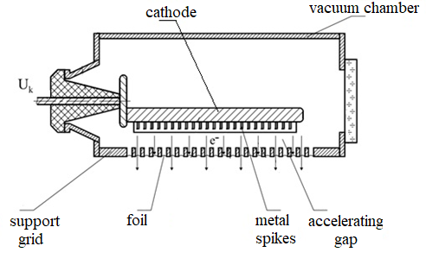
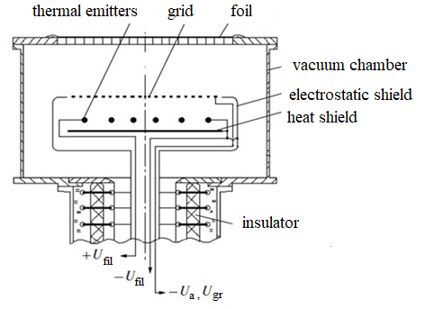
Relevance
Fig. 1- The electron accelerator with explosive emission cathode
Fig. 2- The electron accelerator with thermionic cathode
Notes:
Let’s start with a question: why am I interested in these things? Beams of charged particles have unique properties.
That is why accelerator technology is relevant for both fundamental and applied work.
One of the technology’s nuances is the generation of large cross section electron beams.
These beams are characterized by cross sectional area of about 1000 mm², and often output in the ambient atmosphere through a thin metal foil.
Large cross section beams can provide high performance due to the large processing area.

Slide 4
Relevance
Application examples of electron accelerators with large cross section beams:
Food radiation processing;
Sterilization of medical products;
Pumping gas lasers;
Curing of polymer coatings;
etc.
e
200 keV
Surface
Material
Fig. 3- impact of a low-energy beam on the material surface
Notes:
Application examples of low energy electron beams of large cross section are:
Food radiation processing;
Sterilization of medical products;
Pumping gas lasers;
Curing of polymer coatings;
etc.

Slide 5
The purpose of this research work
The creation of an electron accelerator based on secondary ion-electron emission with a beam power of up to 10 kW and a section of 400x650 mm²
Tasks:
Prepare the vacuum system;
Obtain the necessary accelerating voltage (150 kV);
Determine the current-voltage characteristic of an auxiliary discharge;
Obtain the required electron beam.
Notes:
From the above, it becomes clear that the electron accelerators are also currently relevant.
Therefore the purpose of this work was the creation of an electron accelerator based on secondary ion-electron emission with a beam power of up to 10 kW with a section of 400x650 mm².
Tasks were set:
Prepare the vacuum system;
Obtain the necessary accelerating voltage (150 kV);
Determine the current-voltage characteristic of an auxiliary discharge and
Obtain the required electron beam.
The studied accelerator is based on the process of ion-electron emission, so first we need to address what it is.

Slide 6
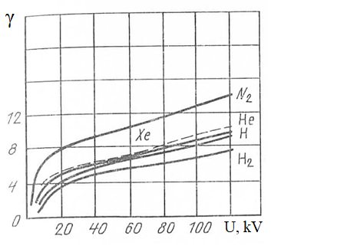
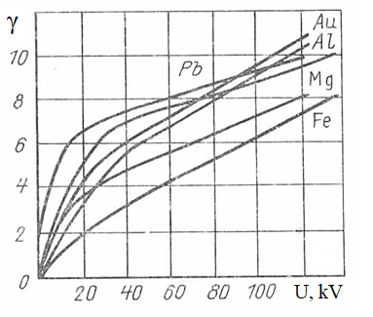
Secondary ion-electron emission
Ion-electron emission is electron emission from the surface of a solid when it is bombarded with ions.
a)
b)
Fig.4 − Dependence of ɣ (U) on the type of gas and substrate material
a) aluminum substrate; b) He ion bombardment
Notes:
What the ion-electron emission phenomenon is basically electron emission from the surface of a solid when it is bombarded with ions.
The efficiency of emission is characterized by a coefficient γ which is equal to the average number of ejected electrons per one ion.
Coefficient γ depends on the energy of the incident particle, type of ion, and the substrate material.

Slide 7
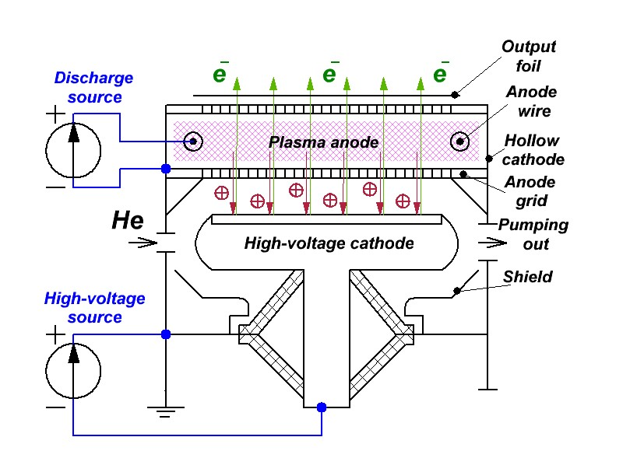
Operation scheme
Fig. 5 — The operation scheme of an electron accelerator based on ion-electron emission
Notes:
Now let's talk about the accelerator itself. The accelerator design (Fig. 5) includes two main parts:
the part where auxiliary discharge is generated to create the anode plasma and the part that is responsible for combustion of nonself-maintained high voltage glow discharge.
The role of the auxiliary discharge is played by a self-maintained glow discharge, in which two tungsten wires are the anode and the walls of the vacuum chamber are the cathode.
The plasma boundary of the auxiliary discharge is kept stable by the anode grid.
Ions extracted from the plasma are accelerated in the gap and bombard the high-voltage cathode of main discharge.
As a result of this bombardment there appear electrons which are also accelerated in this gap and pass through the anode plasma output in the ambient atmosphere.

Slide 8
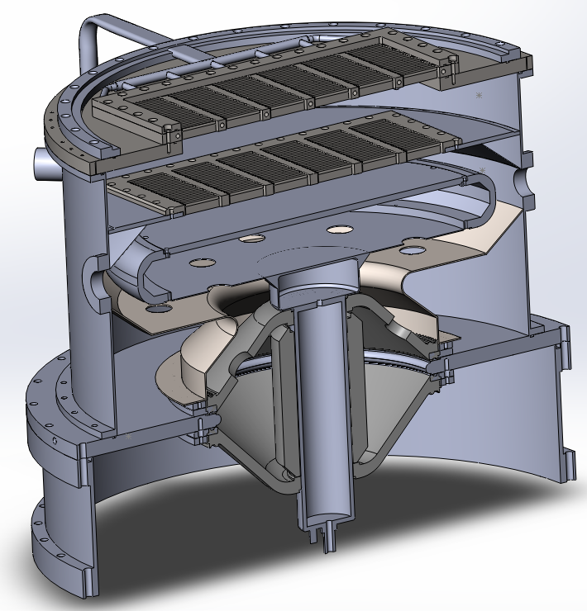
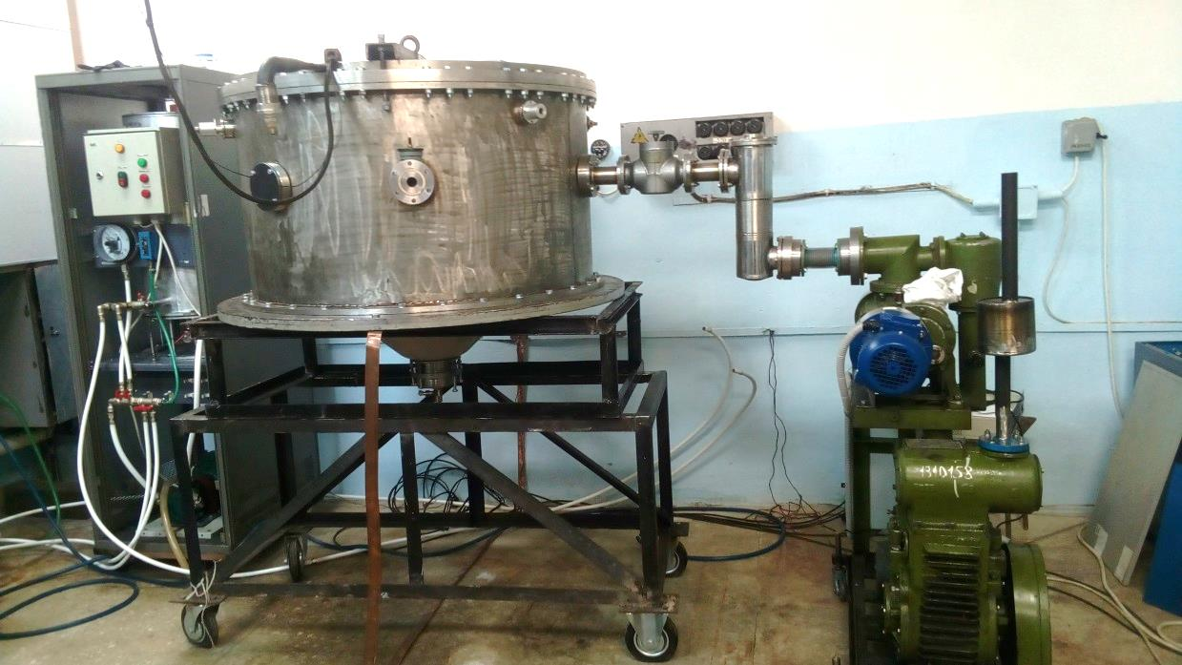
Design and parameters of the accelerator
1
2
3
4
5
6
7
130 см
Fig. 6 — Appearance, design and parameters of the accelerator
1 – Output foil window;
2 – Anode grid;
3 – Cathode;
4 – Pumping out window;
5 – Shield;
6 – Vacuum chamber;
7 – Insulators;
Electron energy up to 150 keV
Current in the accelerating gap up to 100 mА
Beam dimension 400х650 mm
Notes:
The accelerator allows to generate a wide continuous electron beam and output it in the ambient atmosphere.
Beam parameters are as follows: electron energy up to 150 keV, current in the accelerating gap up to 100 mA, beam dimension is 400x650.
One of the main features of the accelerator is a plasma anode formed by an independent glow discharge with a hollow cathode.

Slide 9
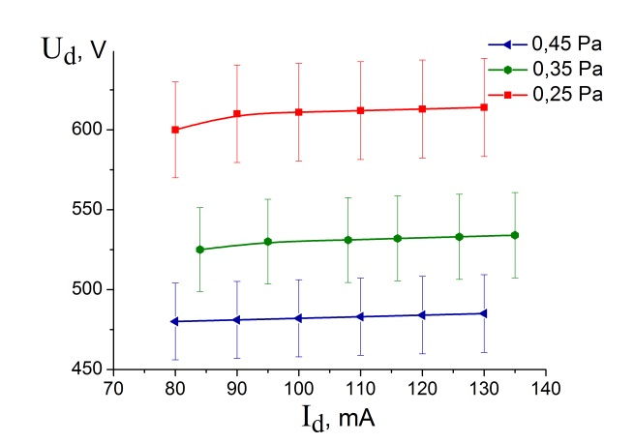
Current-voltage characteristics of an auxiliary discharge
Fig. 7− Current-voltage characteristics of an auxiliary hollow cathode glow discharge at different He pressures
Notes:
The current-voltage characteristics of this discharge were determined depending on the pressure of the working gas and accelerating voltage magnitude.
Figure 7 shows the current-voltage characteristics of a glow discharge at different pressures of the working gas.
It is clear that, as the current increases, the discharge voltage is slightly growing.
With increasing the pressure, the burning voltage decreases due to a bigger number of ionization interactions.

Slide 10
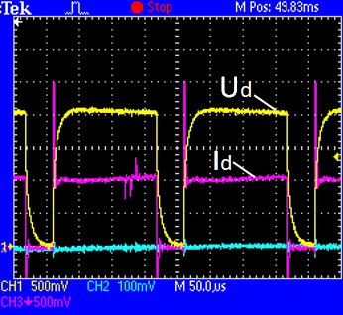
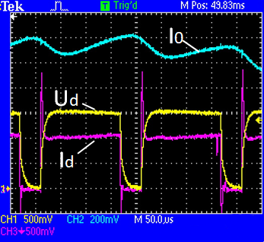
Auxiliary pulse discharge
Ud
Id
Without accelerating voltage U₀= 0 kV
With accelerating voltage U₀= 40 kV
Fig.8 − Oscillograms in the pulse-periodic mode (f = 5 kHz; γ = 80%):
CH1- discharge voltage (140 V/div);
СН2- current in the accelerating gap (10 mА/div);
СН3- discharge current (50 mА/div).
Notes:
In addition to the continuous mode, we tested the pulse mode of discharge burning. Typical waveforms are shown in the slide.
The pulse repetition frequency was 5 kHz and the duty ratio of the pulse was 40 and 80% .
Also, the characteristics were recorded at accelerating voltage.

Slide 11
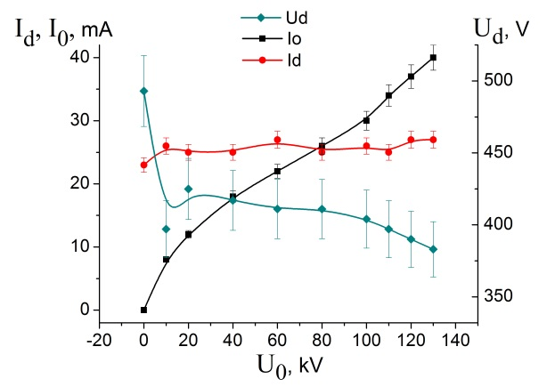
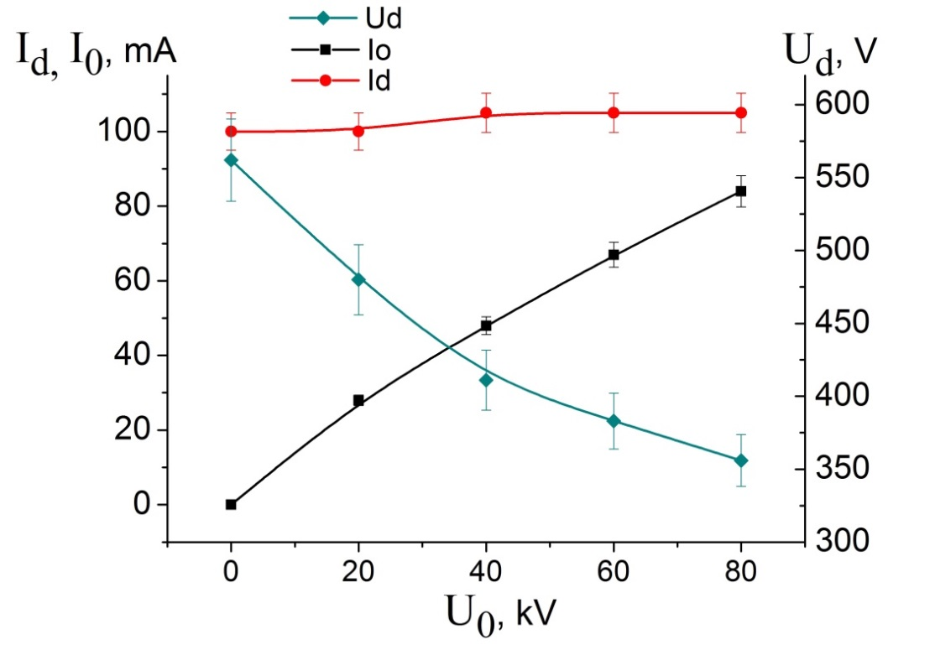
Dependences on accelerating voltage
Continuous mode
Pulse mode f=5 kHz, γ=80%.
Fig. 9 —Dependences of burning voltage U_{d}, discharge current I_{d}, and current in the accelerating gap I₀ on value of accelerating voltage U₀ for different modes of discharge burning
Notes:
When the accelerating voltage is turned on, the burning voltage of the auxiliary glow discharge decreases.
This is due to additional interactions of electrons accelerated from the high-voltage cathode and atoms of the working gas.
The discharge current remains almost unchanged, which is due to the current stabilization mode of the discharge power source.
The increase in current in the accelerating gap is explained by an increase in the secondary electron emission coefficient with a corresponding increase in the energy of the bombarding ions.
These dependencies are similar in nature for both pulsed and continuous operation.
Let’s see what this leaves us with

Slide 12
Conclusion
Was performed launch of an electron accelerator based on ion-electron beam emission with 400x650 mm2 in section and power up to 10 kW.
The current-voltage characteristics of the auxiliary glow discharge are determined in both continuous and pulsed operation modes of the discharge power source.
Notes:
Our efforts resulted in a performed launch of an electron accelerator based on ion-electron beam emission with 400x650 mm² in section and power up to 10 kW.
The current-voltage characteristics of the auxiliary glow discharge are determined in both continuous and pulsed operation modes of the discharge power source.

Slide 13
Plans for the future
Determination of beam parameters outputted in the ambient atmosphere;
Investigation of the accelerator operation with a new auxiliary discharge power source in different generation modes;
Carrying out probe measurements of auxiliary discharge plasma.
Notes:
Our plans for the future are:
Determination of beam parameters outputted in the ambient atmosphere;
Investigation of the accelerator operation with a new auxiliary discharge power source in different generation modes and
Carrying out probe measurements of auxiliary discharge plasma.

Slide 14
Institute of
High Current
Electronics
Thank you
for your attention!
Postgraduate: Doroshkevich Sergey
E-mail: doroshkevich096@gmail.com
14

